Slide 1
Motion
Year 12

Slide 2
Page Setup
Set up the first page of every lesson like this and rule a column line for every page after the first page that is used during the lesson.
Focus: State the Chapter Number, Title and the page numbers (3 lines).
Keywords: During the lesson write out your own keywords used during the lesson. (8 lines)
Context: During the lesson write in this section what this topic relates to in the ‘real’ world. How is this content used to better society? (5 lines)

Slide 3
Motion
Chapter 1.1
Page 4 - 10

Slide 4
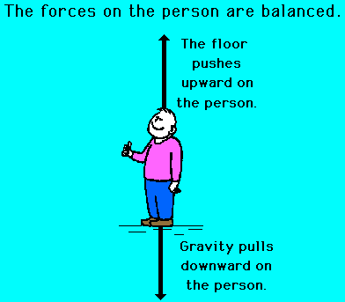
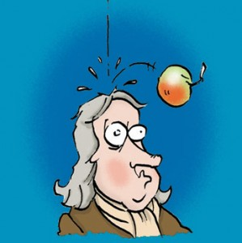
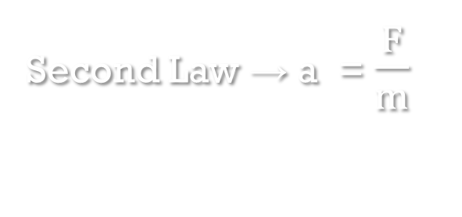
Gravity & Newton’s Laws
Second Law → a = $\frac{F}{m}$
Third Law → Action/Reaction
Combined with
And knowing that the Earth is “mostly spherical”
Means for gravity near the Earth’s surface a = 9.8 m s⁻² (or N s) with respects to the Earths centre of mass.

Slide 5
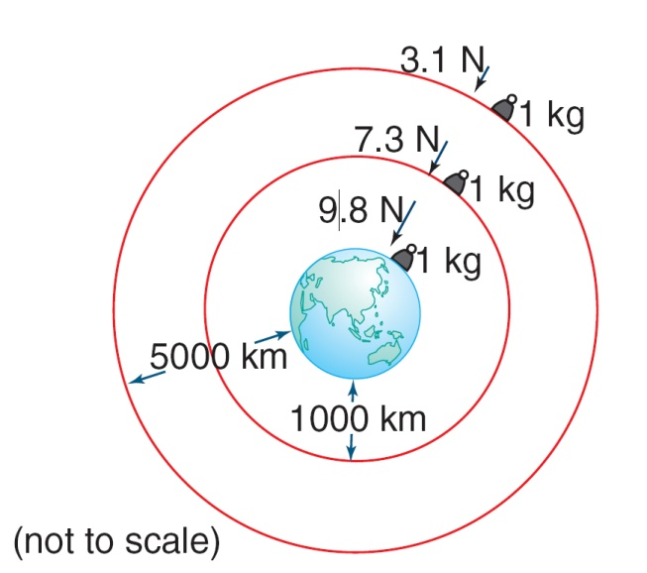
Gravitational Fields
Gravitational forces are always forces of attraction.
The force that the 1.00 kg mass pushes down on the Earth decreases as you move further from the centre of the Earth.
Hence when determining the behaviour of the object (time to fall or distance fallen) then use the equations of motion and let a = 9.8 m s⁻²

Slide 6
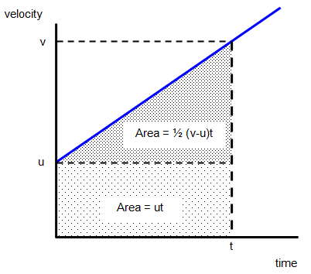
GRAPHICAL EQUATIONS OF MOTION in Vertical Context
Finding acceleration
It is the gradient of the line.
Gradient = a = (v – u)
∆t
Finding displacement
It is the area under the line.
Area = s = u t + ½ (v – u)t
= u t + ½ [ (v – u) t ] t
t
where a = (v – u)
t
Hence = u t + ½ [ a t ] t
= u t + ½ a t²
Finding the other equation
Substitute t = (v – u)
a
into s = u t + ½ a t²
Hence v² = u² + 2 a s

Slide 7
Homework, Context & Keywords
Context: How is this content used to better society?
The application of gravity with respect to the motion of objects.

Slide 8
Homework, Context & Keywords
Key Words
Equations of motion
Gravity
Newton’s Laws

Slide 9
Homework, Context & Keywords
Homework
Complete all questions from Set 1.1 - due first lesson next week.
Read Chapter 1.2, page 10-16 and answer
Q1, 2 & Q3 Set 1.2
by next lesson.

Slide 10
Page Setup
Set up the first page of every lesson like this and rule a column line for every page after the first page that is used during the lesson.
Focus: State the Chapter Number, Title and the page numbers (3 lines).
Keywords: During the lesson write out your own keywords used during the lesson. (8 lines)
Context: During the lesson write in this section what this topic relates to in the ‘real’ world. How is this content used to better society? (5 lines)

Slide 11
Inclined Planes
Chapter 1.2
Page 10 - 16

Slide 12
Vectors and Trigonometric Equations
Some simple common and useful equations.
sin x = o/h
cos x = a/h
tan x = o/a
Some simple common and useful equations
a² = b² + c² – 2bc cosA
sin A = sin B
a b
h
o
x
a
b
A
c
C
a
B

Slide 13
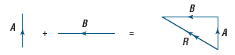
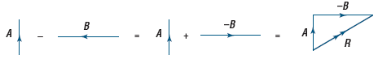
Vectors
Two vectors aiding is the addition of vectors to find the resultant vector.
“Change in …” is the subtraction of vectors to find the resultant vector. That is, Δv = (v − u) or Δv = v + (−u).

Slide 14
Complex Trigonometry
Example 1.2a: Solve the resultant by the addition of these two vectors.
20 m s⁻¹
30 m s⁻¹
25º
25º

Slide 15
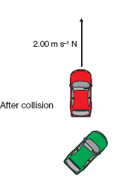
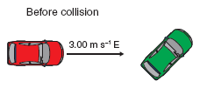
Vectors
Example 1.2b: A red bumper car travels over the track at 3.00 m s^{–1} east. It collides with a green bumper car and is deflected so that it ends up travelling at 2.00 m s^{–1} north. Calculate the change in:
a) speed of the red bumper car
b) velocity of the red bumper car.
a) u = 3.00 ms⁻¹ Δspeed = Δv = v - u
v = 2.00 ms⁻¹ Δv = (2.00 – 3.00)
= -1.00 ms⁻¹
The red bumper car has slowed from 3.00 m s^{–1} to 2.00 m s^{–1}.
The change in speed is −1.00 m s^{–1}.

Slide 16
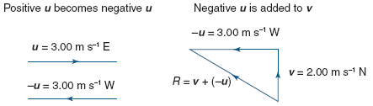
Example 1.2B Continued
b) velocity of the red bumper car.
First calculate the magnitude of Δv from Pythagoras’s theorem:
u = 3.00 ms⁻¹ east Δvelocity = Δv = v + (- u)
-u = 3.00 ms⁻¹ west Δv² = (v)² + (-u) ²
v = 2.00 ms⁻¹ north Δv² = (2.00)² – (-3.00) ²
Δv = 3.61 ms⁻¹
Then calculate the direction using trigonometry:
tan θ = -u/v = 3.00/2.00
θ = tan (1.50) = 56.3°
The change in velocity of the red bumper car is
3.61 m s^{–1} N 56.3°W.

Slide 17
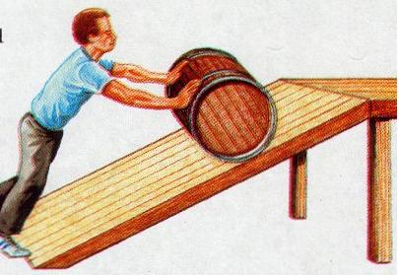
Inclined Planes
N_{F}
Weight Force (W_{F}) is perpendicular to the ground (action)
Other force components
Normal Force – N_{F} (reaction)
Frictional Force – F_{F} (reaction)
Motion Force (M_{F}) is the object sliding down the slope (action)
F_{F}
M_{F}
W_{F} = m g

Slide 18
Inclined Planes
N_{F}
N_{F}
F_{F}
F_{F}
M_{F}
M_{F}
W_{F} = m g
W_{F} = m g
F_{F}
F_{F}
M_{F}
M_{F}
The resultant is
∑F
The resultant is
∑F
This means it is accelerating down the slope (F = m a)
This means it is accelerating up the slope (F = m a)

Slide 19
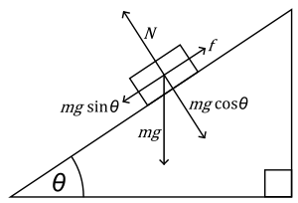
Inclined Planes

Slide 20
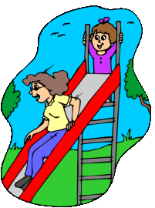
Inclined Planes
Example 1.2c: Julie takes her younger sister Mary to the park. They both want a go on the slippery slide. Julie, who has a mass of 55 kg goes first. When she watches Mary, who has a mass of 35 kg, she notices she goes slower. If the slide is on an angle of 30º to the horizontal,
compare the force they each experience when they reach the ground and
predict what accelerations they experienced.
Is Julie’s assumption correct?

Slide 21
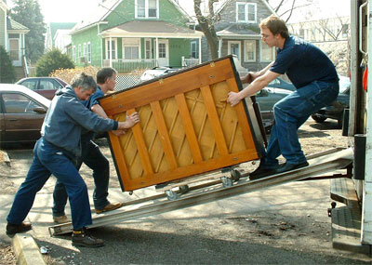
Inclined Planes
Example 1.2d: Steve and John are pushing the piano, which is on a trolley, up a 20º ramp, while Michael helps by pulling it up. Steve gets distracted by something he has left near the tree and leaves the others. At the same
time John lets go to scratch his nose. What force does poor Michael have to apply to hold the 380 kg Piano in its current position while the other two get their act together and finish helping get the piano into the truck.

Slide 22
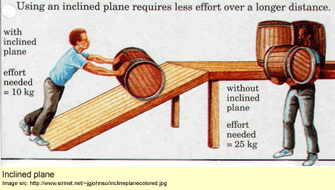
Inclined Planes

Slide 23
Homework, Context & Keywords
Context: How is this content used to better society?
The advantages to using levels and mechanics to manoeuvre heavy items.

Slide 24
Homework, Context & Keywords
Key Words
Vectors
Trigonometry
Inclined Planes Addition of Vectors
Change in (Subtraction) of Vectors

Slide 25
Homework, Context & Keywords
Homework
Complete all questions from Set 1.2 - due first lesson next week.
Read Chapter 1.4, page 21-31 and answer
Q1, & Q2 Set 1.4
by next lesson.

Slide 26
Page Setup
Set up the first page of every lesson like this and rule a column line for every page after the first page that is used during the lesson.
Focus: State the Chapter Number, Title and the page numbers (3 lines).
Keywords: During the lesson write out your own keywords used during the lesson. (8 lines)
Context: During the lesson write in this section what this topic relates to in the ‘real’ world. How is this content used to better society? (5 lines)

Slide 27
Circular Motion
Chapter 1.4
Page 21 - 31

Slide 28
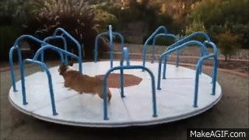
Horizontal Circular Motion

Slide 29
Horizontal Circular Motion
This requires a force, F, towards the centre of the motion to keep the object on a curved path.
v
Newton’s 1st Law:
“I want to go straight on!”
v
F
A CENTRIPETAL FORCE
F
Something has to provide its ability to stay on that circular path,
e.g. the tension in a string

Slide 30
Horizontal Circular Motion
SUMMARY
v
Centripetal Force
Linear Velocity
v = r ω
v
F_{c} & a_{c}
θ
Angular Velocity
where θ is in radians
F_{c} & a_{c}
Centripetal Acceleration

Slide 31
Horizontal Circular Motion
Speed is constant but its velocity is continually changing. (Velocity is a vector, so the direction of motion is significant).
a_{c} = v² = 4 π² r , as v = s = 2 π r
r T² t T
F_{c} = ma_{c} = m v² = 4 m π ² r
r T²

Slide 32
Horizontal Circular Motion
Example 1.4a: A mass of 100 g is whirled in a horizontal circle at one end of the string 0.8 m long. The other end is fixed to the centre of the circle. If the string, when hanging vertically, just supports a load of 112 N without breaking, find the maximum whirling speed in metres per second and in revolutions per second.

Slide 33
Horizontal Circular Motion
Example 1.4b: If the track has a radius of 50m and the limiting frictional force is 0.5 of the car’s weight, find the car’s maximum speed before it slides off the track.
HINT: The necessary centripetal force, F is provided by the friction at the tyres.
F

Slide 34
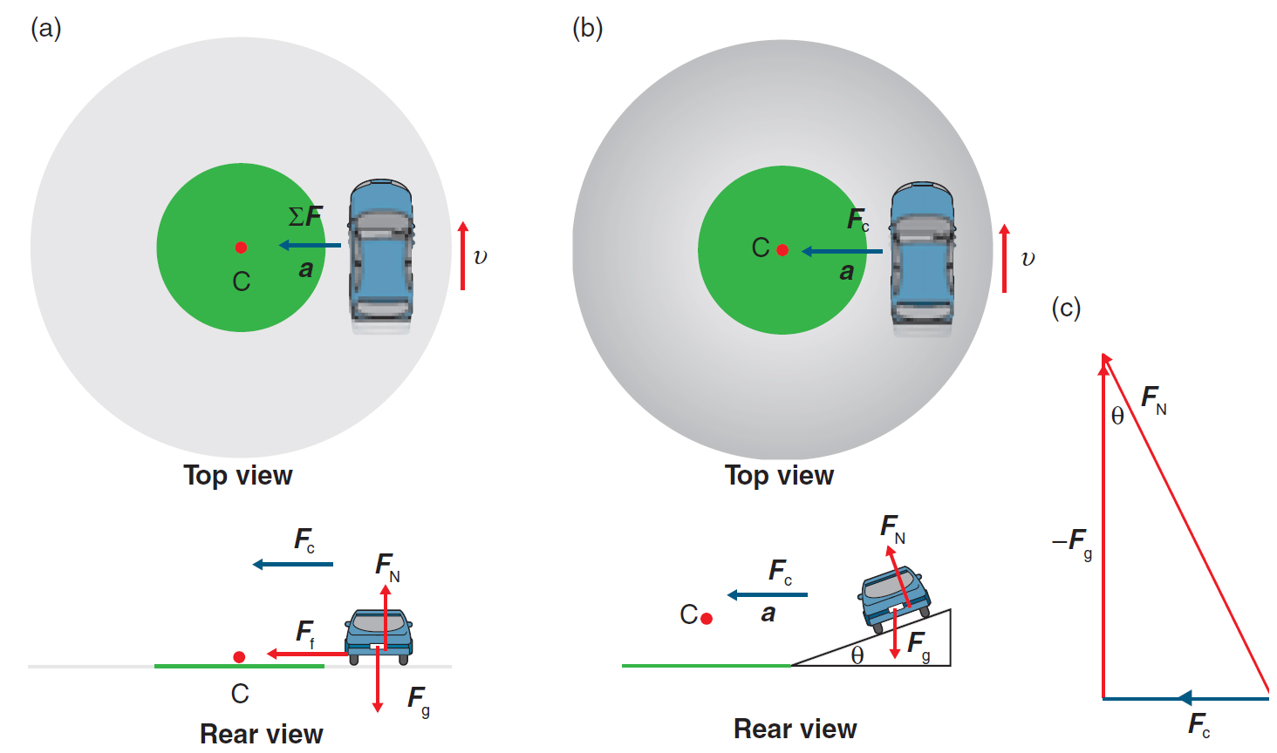
Banked Corners
This is where inclined planes and horizontal circular motion are combined. By applying a banked corner the need to rely on the frictional force of the tyres is reduced significantly.
The centripetal force (reaction) and weight force (action) combine to counteract the normal force (reaction)
F_{c} + - F_{g} = F_{N}.

Slide 35
Banked Corners
Example 1.4c: A curved section of track on an Olympic velodrome has a radius of 50.0 m and is banked at an angle of 42º to the horizontal.
Calculate the centripetal force acting on a cyclist (75.0 kg) riding at the design speed.
At what speed would a cyclist of mass 75.0 kg need to travel if they were to experience zero frictional forces up and down the bank of the track. i.e . What is the design speed for this section of the velodrome for a 75.0 kg person?
Would a lighter person be able to go faster or slower around this section. Use mathematical concepts to support your answer.

Slide 36
Banked Corners
Example 1.4d: A curved section of the NASCAR track at Daytona International speedway has a radius of 304.8 m along a 1 km strip and is banked at an angle of 41º to the horizontal.
Calculate the centripetal force acting on a motorist driving at the design speed.
In 1987, Bill Elliot and his 1130 kg car (inc drivers weight) clocked a record 338 km h⁻¹. Show this is not possible on a frictionless banked surface?
Since it is not possible on a frictionless surface, tyre friction would have to account for some of the grip in keeping the car in place. Draw a new vector diagram to include the tyre friction and calculate the tyre friction needed to achieve this record.

Slide 37
Banked Corners
Example 1.4e: Arvind wants to go around a bend on a level road, where the radius of the bend is 60 m and his mass is 100 kg (including the bike). If the maximum frictional force of 500 N, at what angle should he lean to negotiate the angle.

Slide 38
Banked Corners
Example 1.4f: An aeroplane travelling at a speed of 500 km h⁻¹ tilts at an angle 30º as it makes a turn. What is the radius of the curve?

Slide 39
VERTICAL Circular Motion

Slide 40
Vertical Circular Motion
At the BOTTOM
FORCES ACTING:
Weight and either
Tension in the string
or
Normal force
At the bottom the tension has to provide a centripetal force AND support the weight
T or N
F_{c}
v
mg

Slide 41
Vertical Circular Motion
At the TOP
FORCES ACTING:
Weight and either
Tension in the string
or
Normal force
At the top tension is less than at the bottom, because the weight provides some of the centripetal force
v
F_{c}
mg
T or N

Slide 42
Vertical Circular Motion
At the TOP
FORCES ACTING:
Weight and either
Tension in the string
or
Normal force
At the top tension is less than at the bottom, because the weight provides some of the centripetal force
v
F_{c}
mg
T or N

Slide 43
Vertical Circular Motion
Example 1.4g: A ball at the end of a string is revolving at a steady state in a vertical circle of radius 1.1 m. If its speed is 3.75 m s⁻¹ and its mass is 0.355 kg, calculate the tension in the string at the top of the path and the bottom of the path.

Slide 44
Vertical Circular Motion
Example 1.4h: The Woolworths Shopping Centre wants to construct a speed hump in the car park and restrict the speed limit to 5 km h⁻¹. What should the radius of the hump be if the car lifts off the surface when the speed exceeds this limit?

Slide 45
Vertical Circular Motion
Example 1.4i: A fan with blades 25.4 cm in diameter is rotating at a rate of 1740 rpm. What is the speed of a point at the tip of one blade of the fan?

Slide 46
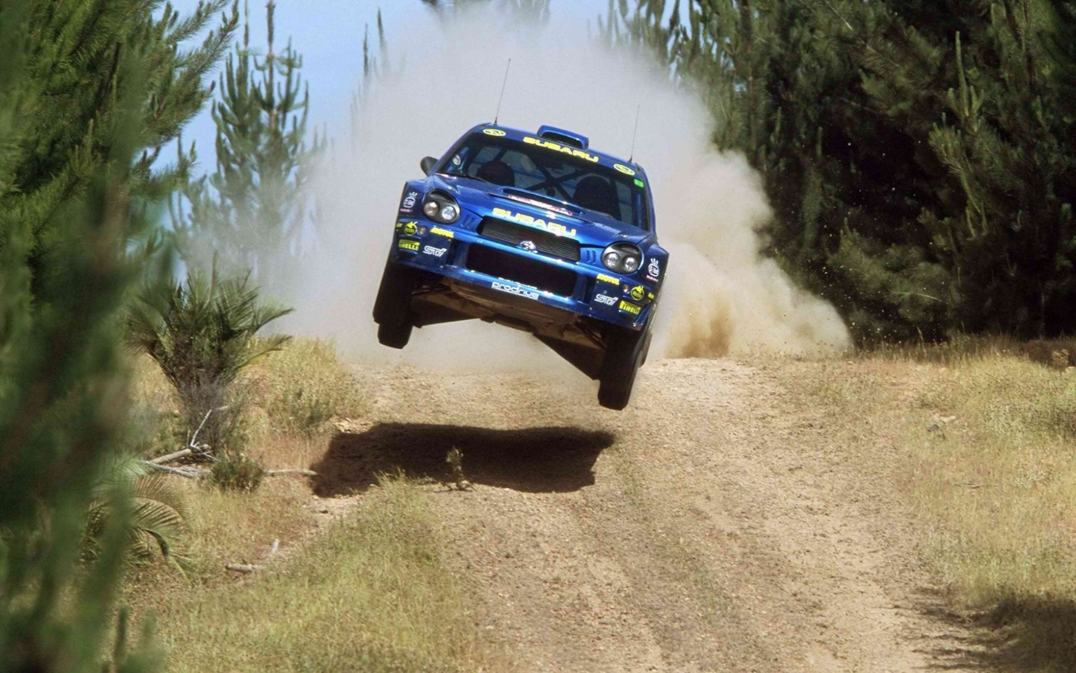
Vertical Circular Motion
Example 1.4j: During a car rally it is quite common to see a car travelling at high speed become airborne as it travels over a rise in the road. This occurs because the speed of the car is too great for the radius of curvature of the road. Assume a rally car of mass 1110 kg hits a rise of radius 4.5 m.
What is the minimum
speed would it need
to be travelling in
order to experience
lift off the ground.

Slide 47
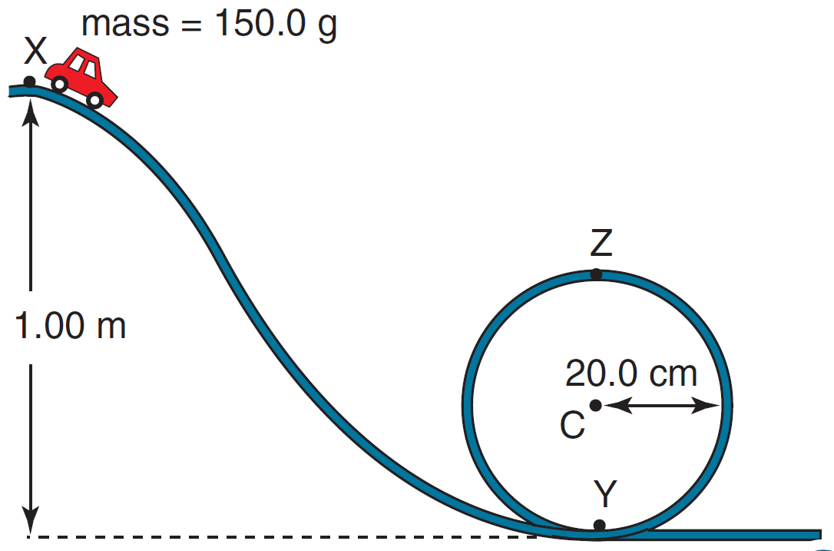
Vertical Circular Motion
Example 1.4k: A student arranges a toy car track with a vertical loop of radius 0.200 m, as shown. A car of mass 150.0 g is released from a height of 1.00 m at point X. The car rolls down the track and travels around the loop. Assuming g is −9.80 m s^{–2}, and ignoring friction, calculate the:
speed of the car as it reaches the bottom of the loop, point Y.
centripetal acceleration of the car at point Y.
reaction force of the track on the car at point Y.
speed of the car as it reaches the top of the loop at point Z.
reaction force of the track on
the car at point Z.
release height from which the
car will just maintain contact
with the track as it travels past
point Z.

Slide 48
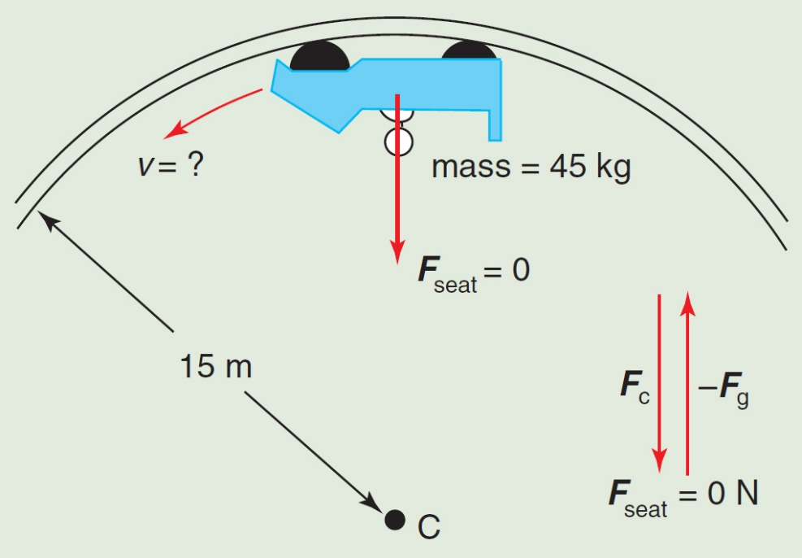
Vertical Circular Motion
Example 1.4l: consider a ride of radius 15 m in a simple vertical circle. It is possible to calculate the speed that would ensure that a rider cannot fall out, yet still experiences zero g. We will assume that the person has a mass of 45 kg and that gravity is −9.80 m s^{–2}.
Draw a diagram showing all the forces and dimensions.
Calculate the ideal velocity.

Slide 49
Homework, Context & Keywords
Context: How is this content used to better society?
To design safer roads and more exhilarating rides.

Slide 50
Homework, Context & Keywords
Key Words
Inclined Plane
Banked Corners
Horizontal Circular Motion
Vertical Circular Motion

Slide 51
Homework, Context & Keywords
Homework
Complete all questions from Set 1.4 - due first lesson next week.
Read Chapter 1.3, page 16-21 and answer
Q1, & Q2 Set 1.3
by next lesson.

Slide 52
Page Setup
Set up the first page of every lesson like this and rule a column line for every page after the first page that is used during the lesson.
Focus: State the Chapter Number, Title and the page numbers (3 lines).
Keywords: During the lesson write out your own keywords used during the lesson. (8 lines)
Context: During the lesson write in this section what this topic relates to in the ‘real’ world. How is this content used to better society? (5 lines)

Slide 53
Projectile Motion
Chapter 1.3
Page 16 - 21

Slide 54
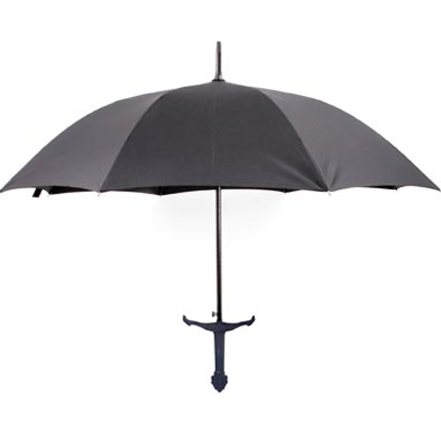
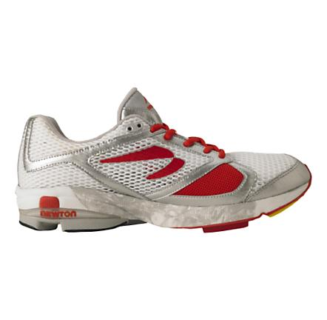
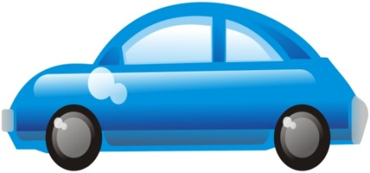
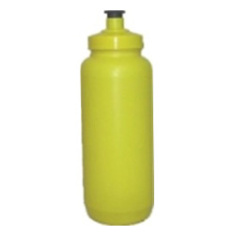
Centre of Mass
Centre of Mass accounts for the 2D or 3D (dimensional) point of balance of any object.
Every object, no matter how complex has a centre of mass.
Estimate the 2 dimensional Centre of Mass of the following objects.
Calculating the centre of mass requires the object to be broken up into definite shapes.

Slide 55
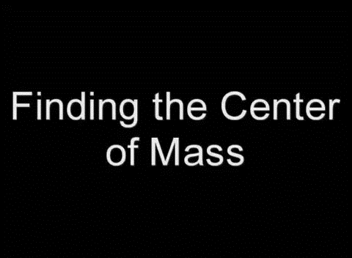
Centre of Mass

Slide 56
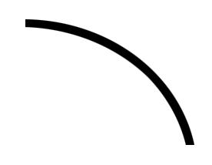
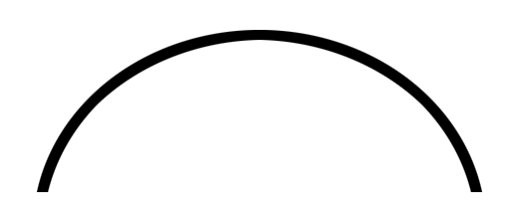
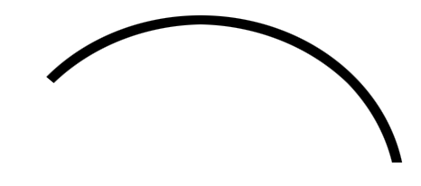
Projectile Motion
Example: car driving off a cliff
Half Projectile
Full Projectile
Partially Projectile
Example: Javelin throw
Example: shot put throw

Slide 57
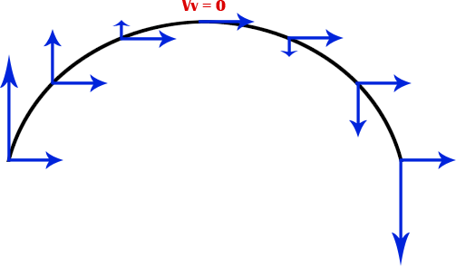
Projectile Motion
Important Information
Treat your vertical and horizontal as separate components.
v_{h} remains constant,
v_{v} (at max height) = 0
a_{h} = 0,
a_{v} = 9.8 ms⁻²
Assumptions
air resistance is ignored.

Slide 58
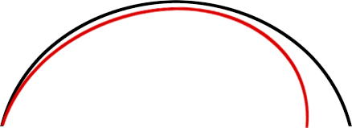
Projectile Motion
When considering air resistance
Bull nose
Less height
Which hits the ground first?
Black line – air resistance results in the object slowing down, hence it does not reach full height, but it is falling at a slower rate than if there was no air resistance. Hence the air resistance slows the object continuously relative to the object not experiencing air resistance.

Slide 59
Half Projectile Motion
Example 1.3a: A rally car misses the corner and continues over a 40 m cliff with a speed of 10 m s⁻¹, into the sea. (Ignoring air resistance)
a) How long does it take the car to land into the water?
b) How far from the base of the cliff does it land?
c) What is the velocity of the car at impact?

Slide 60
Half Projectile Motion
Example 1.3b: Gun fired horizontally from a cliff at height 30 metres at a speed of 40 m s⁻¹.
(Ignoring air resistance)
a) How long does it take to hit the ground below?
b) How far from the base of the cliff does it land?
c) What is the velocity of the bullet at impact?

Slide 61
Half Projectile Motion
Example 1.3c: A ball is thrown horizontally from a height of 3 m at 20ms⁻¹ from a moving vehicle travelling in the same direction at 10ms⁻¹ . Assuming there is no air resistance, where will the ball land relative to the vehicle?

Slide 62
Full Projectile Motion
Example 1.3d: Cannon ball is fired into the air at 50 m s⁻¹ at an angle of 37.5º to the horizontal. Assuming no effects from air resistance.
a) Find the maximum height
b) Find its time in flight.
c) Find its range.

Slide 63
Full Projectile Motion
Example 1.3e: One student throws a ball to another student who is the same height at a speed of 19 m s⁻¹ at an angle of 41º from horizontal. (Ignoring air resistance)
a) How long does it take to reach the other student?
b) How far does the ball travel to reach the other student?
c) Find the maximum height?

Slide 64
Full Projectile Motion
Consider the range of a projectile dependent on its angle of trajectory.
Example 1.3f: A bullet leaves the barrel of a gun at 400 m s⁻¹. Find the maximum height obtained, total flight time and its range, if the barrel is aimed at 15º, 30º, 45º, 60º, and 75º to the horizontal.

Slide 65
Equations for the memory (optional)
s_{v} = (u sin θ)²
2g
t = (2u sin θ)
g
s_{H} = (u cos θ)t

Slide 66
Partial Projectile Motion
Example 1.3g: An athlete rests a shot put on their shoulder at 1.5 metres above the ground. The shot put is launched at a 30º angle above horizontal and at a speed of 6.5 m s⁻¹ (Ignoring air resistance).
a) What is the vertical displacement of the ball between the launch point and where it strikes the ground?
b) Calculate the time of travel of the ball.
c) Calculate the range of the ball.

Slide 67
Partial Projectile Motion
Example 1.3h: A Cannon fires a cannon ball from a cliff 12 metres high at an angle of 30º from horizontal and at a speed of 36 m s⁻¹ (Ignoring air resistance).
a) Calculate the time of travel to hit the ground below?
b) How far does the cannon ball travel before impact?
c) Find the maximum height from the point of impact?

Slide 68
Partial Projectile Motion
Example 1.3i: Natasha releases a ball from the free-throw line with a velocity of 7 m s⁻¹ at an angle of 51º from the horizontal. The ball was released at a height of 2.3 m above the ground and the basket is 3.05 m high. If the ball passes exactly through the hoop as it is falling, calculate; (Ignoring air resistance).
a) The time of flight.
b) The distance between the free throw line and the centre of the hoop.

Slide 69
Homework, Context & Keywords
Context: How is this content used to better society?
To design and understand how objects fall and behave during two dimensional motion.

Slide 70
Homework, Context & Keywords
Key Words
Centre of Mass
Projectile motion
Partial
Full
Half
Air Resistance
Bull nose

Slide 71
Homework, Context & Keywords
Homework
Complete all questions from Set 1.3 - due first lesson next week.
Read Chapter 2.3, page 58-61 and answer
Q1, & Q2 Set 2.3
by next lesson.

Slide 72
Page Setup
Set up the first page of every lesson like this and rule a column line for every page after the first page that is used during the lesson.
Focus: State the Chapter Number, Title and the page numbers (3 lines).
Keywords: During the lesson write out your own keywords used during the lesson. (8 lines)
Context: During the lesson write in this section what this topic relates to in the ‘real’ world. How is this content used to better society? (5 lines)

Slide 73
Energy
Chapter 2.3
Page 58 - 61

Slide 74
Energy
There is a change in energy when;
a mass moves or is moved from one point to another in a gravitational field and its potential energy changes, work is done on the mass by the field.
energy changes from one form to another.

Slide 75
heat
heat
potential
chemical
electromagnetism
kinetic
sound
light

Slide 76
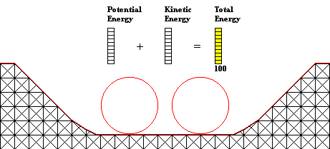
Conservation of Energy
Energy can be neither created nor destroyed.
In an isolated system it can transform into other forms of energy.
In general, it can transfer to other systems and/or transform into other forms of energy.

Slide 77
Energy Transformation
Example 2.3a: A cyclist in the Tour de France expels on average 41600 kJ of energy a day. If 35% transforms into heat and is transferred to the surrounding air and 5% is converted into the sound energy created by the friction between the wheels and the road, how much energy is used as mechanical energy to move the bike along?

Slide 78
Work
An object is said to have energy if a change occurs.
Definition: What is accomplished on an object by the action of the force.
WORK DONE = FORCE X DISTANCE MOVED
W = F s
Force F
Force F
Distance s

Slide 79
Work
W = F s . Cos θ
Force F
θ
Distance s

Slide 80
Potential Energy
Definition: The stored energy, giving the object the potential to do work.
Work done = Potential Energy gain
Δh
mg
E_{P} = m g Δh

Slide 81
Kinetic Energy
Final
velocity v
F
Mass m
Initial velocity u =0
s
Definition: An object in motion has the ability to do work.
E_{K} = work done in accelerating to velocity, v. i.e E_{K} = Fs
E_{K} = ½ m v²

Slide 82
Energy
Example 2.3b: Calculate the work done by a man who drags a 25 kg bag of salt across the pavers against a frictional force of 55 N for a distance of 12 m.
Example 2.3c: What is the work done by a 45 kg girl when she climbs up an almost vertical ladder 15 m high?
Example 2.3d: A girl pulls a cart by applying a force on the cart handle. The girl can adjust the height of the handle to 45º and 30º. What position will require the least amount of work? (Need to show this using mathematical terms)

Slide 83
Energy
Example 2.3e: A car of mass 1120 kg is travelling at 80 km h⁻¹ and slows to 30 km h⁻¹ as it approaches a road works site. The distance travelled during the deceleration is 100 m. Determine;
The cars initial Kinetic Energy
The “Work Done” by the brakes in slowing the car down.
The average force applied by the brakes.

Slide 84
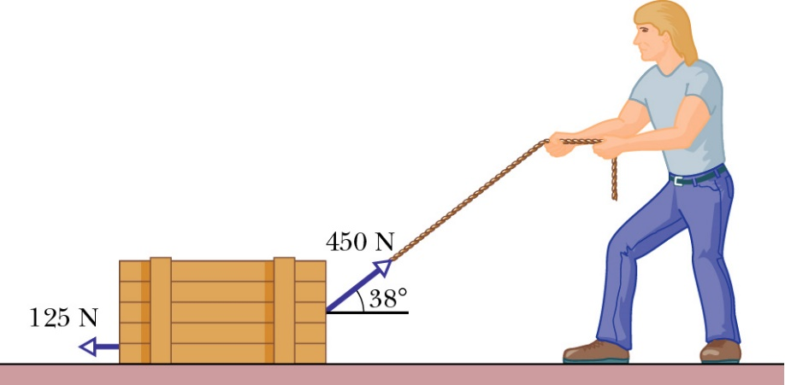
Energy
Example 2.3f: A man is pulling a box that weighs 50 kg, as shown below. What is the work done if he drags the box 45 m?

Slide 85
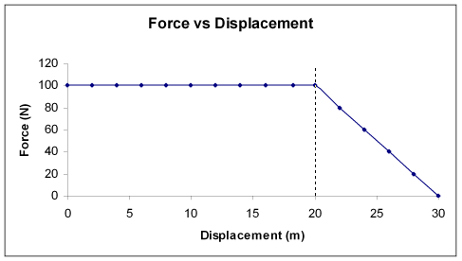
Energy
Example 2.3g: Lucy is pushing a box with a constant force of 100 N for 20 m, before linearly decreasing to force to zero for a further 10 m.
Draw a graph showing this motion.
What is the work done in the first 15 m?
What is the work done in the last 15 m?
A
B

Slide 86
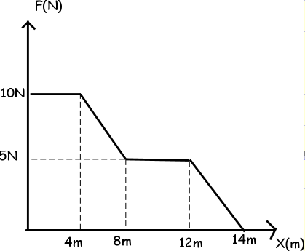
Energy
Example 2.3h: When John was a small child, he would often tire quickly. One day he decided to drag a box outside to play. Initially he had plenty of energy and applied a 10 N force for 4 m. Being a wee lad he soon after quickly lost some of his will-power and so declined his efforts linearly to 5 N for the 4 m after that. Amazingly, he held this effort of 5N for a further 4 m.
To the point of almost exhaustion Wally slowly lost momentum and came to a stop 2 m after that.
Draw a graph showing this motion.
What is the work done in the first 8 m?
What is the work done during the entire journey?
A
B
C
D
E

Slide 87
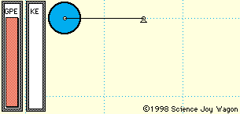
Energy
Example 2.3i: Sheldon is practising weightlifting by lifting a 160 kg barbell a distance of 1.9 m from the floor. He completes the lift in 1.25 s, holds the barbell for 3 s and then allows it to drop to the floor.
How much work has Sheldon done in lifting the barbell?
How much potential energy does the barbell have while being held up for 3 s?
When the barbell is
dropped, what is the
maximum velocity?

Slide 88
Homework, Context & Keywords
Context: How is this content used to better society?
The understanding the principles behind energy interaction to better explain the interactions and operations in motion.

Slide 89
Homework, Context & Keywords
Key Words
Energy
Work
Force
Joules
Potential Energy
Kinetic Energy

Slide 90
Homework, Context & Keywords
Homework
Complete all questions from Set 2.3 - due first lesson next week.
Read Chapter 1.5, page 32-40 and answer
Q1, & Q2 Set 1.5
by next lesson.

Slide 91
Page Setup
Set up the first page of every lesson like this and rule a column line for every page after the first page that is used during the lesson.
Focus: State the Chapter Number, Title and the page numbers (3 lines).
Keywords: During the lesson write out your own keywords used during the lesson. (8 lines)
Context: During the lesson write in this section what this topic relates to in the ‘real’ world. How is this content used to better society? (5 lines)

Slide 92
Torque & Equilibrium
Chapter 1.5
Page 32 - 40

Slide 93
Torque
Three factors to consider
Magnitude of Force
Perpendicular distance from line of action of force to the pivot point.
Angle of applied force in relation to the perpendicular applied force.

Slide 94
Torque
τ = F r ⊥
τ = Torque (N m)
F = Force (N)
r⊥ = Perpendicular distance from the applied force to the pivot point (m).

Slide 95
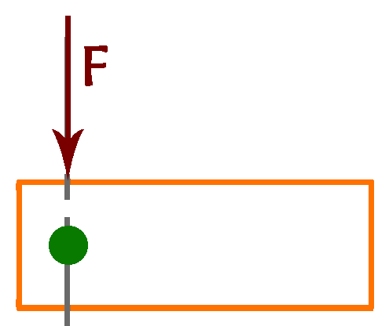
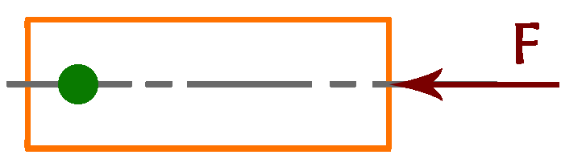
Torque
Zero Torque
This occurs when…..

Slide 96
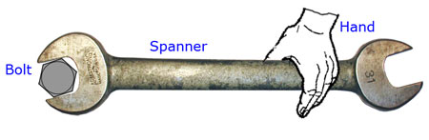
Torque
Example 1.5a: A force of 125 N is applied by Paula using a spanner to loosen a bolt as shown,
Assuming the force is applied perpendicular to the spanner, find the torque.
The nut proves too tight. If 125 N is the maximum force that Paula can apply when holding the spanner, as shown in the diagram, suggest a possible solution she can use to loosen the nut.
25 cm

Slide 97
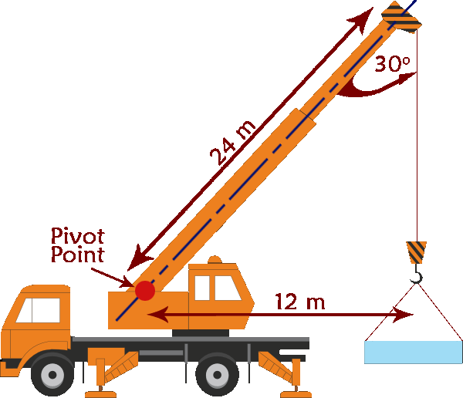
Torque
Example 1.5b: A crane, as depicted, has to lift a concrete mass of 2.1 tonnes. Ignoring the
mass of the cables;
What is the weight of the
concrete mass?
The concrete mass is lifted,
using the cable only, to near
the top of the crane. How does the torque about the pivot change?
Calculate the magnitude of the torque about the pivot.

Slide 98
Torque
mg x d is a clockwise moment
SCHOOL BUS
G
Centre of mass (G)
WV03 VXP
Pivot
d
That’s OK!
mg

Slide 99
Torque
Centre of mass (G)
SCHOOL BUS
SCHOOL BUS
SCHOOL BUS
But at least WE
know about
Moments
SCHOOL BUS
SCHOOL BUS
G
Oh
dear!
WV03 VXP
WV03 VXP
WV03 VXP
WV03 VXP
WV03 VXP
Pivot
d
mg
mg x d kicked it over !!

Slide 100
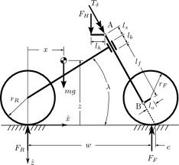
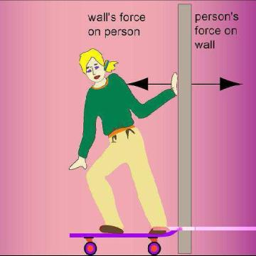
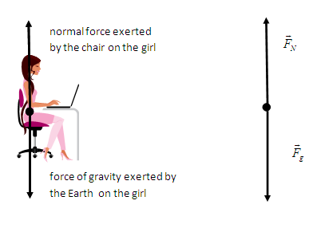
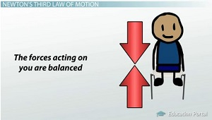
Translational Equilibrium
If the forces acting on the body are balanced, then the body is in equilibrium.
ΣF = 0
ΣF_{action} = ΣF_{reaction}

Slide 101
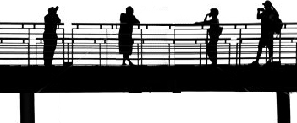
Translational Equilibrium
Example 1.5c: People are crossing the bridge, as illustrated below. The bridge has a mass of 123 kg and the mass of people are 55 kg, 65 kg, 45 kg and 68 kg respectively.
Draw a free body diagram.
If the right hand support of the bridge is found to take 1840 N while these people are crossing, then what force would the support on the left side of the bridge be experiencing?
A B C D

Slide 102
Translational Equilibrium
Example 1.5c: Free body diagram.
A B C D
A B C D
F_{L}
F_{R}
539 N
637 N
441 N
666 N
1205 N
Draw simple bridge
Add action forces
Add reaction forces

Slide 103
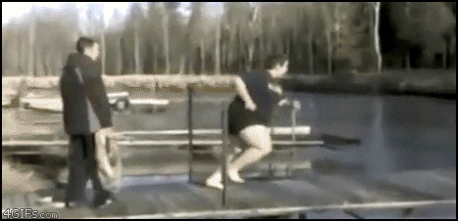
Translational Equilibrium
All the forces in the upwards direction have to equal all the forces in the downward direction, else the object (e.g. Bridge) fails.

Slide 104
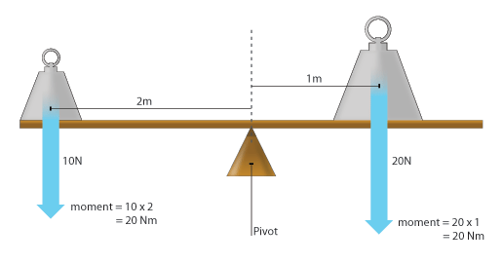
Rotational Equilibrium
If the moments acting on the body are balanced, then the body is in equilibrium.
Σ τ = 0
Σ τ _{clockwise} = Σ τ _{anticlockwise}

Slide 105
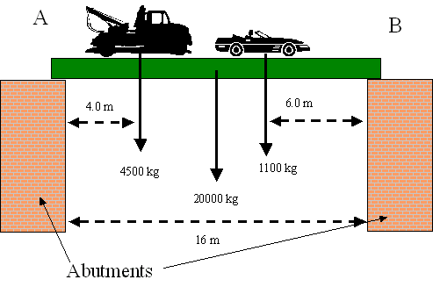
Rotational Equilibrium
Example 1.5d: Given the following illustration, calculate the force each abutment would experience.

Slide 106
Rotational Equilibrium
Example 1.5d: Draw a free body diagram and convert all masses to forces.
T Br C
4 m
8 m
10 m
F_{A}
16 m
F_{B}
4.41 x 10⁴ N
1.96 x 10⁵ N
1.078 x 10⁴ N

Slide 107
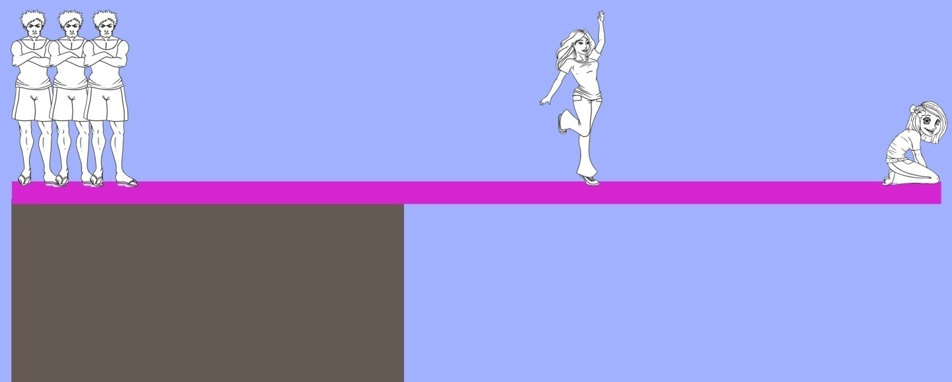
Equilibrium
Example 1.5e: Given the following illustration
Three people of mass 60 kg, 60kg, and 65kg respectively are standing on one side of a timber plank, that is resting on solid ground. Another person, mass 60 kg is standing at the end of the cantilevered section. Another person (X) of mass 75 kg starts walking out along the cantilevered section of the plank.
1 m
2 m
? m

Slide 108
Equilibrium
Example 1.5e:
Draw a free body diagram, showing the action and reaction forces and the pivot point.
What is the force being supplied to the pivot point.
What is the furthest point from the pivot can person X be before the system fails.
60 kg, 60kg, & 65kg respectively,
75 kg 60 kg
A X B
1 m
2 m
? m

Slide 109
Equilibrium
Example 1.5e: Free Body Diagram
A X B
1 m
2 m
? m
Pivot Point
A X B
1 m
2 m
1 m
? m
F_{A} = 9.8 x (60 + 60 + 65)
= 1813 N
F_{X} = 9.8 x 75
= 735 N
F_{B} = 9.8 x 60
= 588 N

Slide 110
Equilibrium
Example 1.5f: Julie is working out the best position from which to balance Chelsea and Hannah, who are both on the other end of the seesaw. Her mass is 52 kg and she is 1.05 m from the pivot point of a seesaw of mass 20 kg. Hannah (15 kg) and Chelsea (22 kg) are respectively 1.10 m and 1.60 m from the pivot point on the other side.
Draw a vector diagram, showing all the forces.
Calculate the clockwise and anticlockwise moments (torque).
Does equilibrium exist? If not, where should Julie sit to achieve balance?
Calculate the magnitude of the reaction force.

Slide 111
Equilibrium
Example 1.5g: John is using a lever of mass 6.70 kg to raise a heavy rock of mass 85.0 kg. The lever is 2.10 m in length and resting at an angle if 10º. The rock is measured 20 cm from one end and 50 cm from the pivot point. John is at the far end on the other side of the pivot.
Draw a vector diagram, showing all the forces.
Calculate the force that John has to apply downwards in order to just lift the rock.
What is the reaction force at the pivot, given John starts to raise the rock?

Slide 112

Equilibrium
Example 1.5h: Sitting on a swing, as pictured. Find the tension on the rope, given the mass of the child and swing is 90 kg.
20º

Slide 113
Equilibrium
Example 1.5i: Find the tension in the tie rope, as pictured below. Where the mass of the beam is 2.5 kg.
Tie
Pivot
Beam
30º
1.5 m
10 kg
1.7 m

Slide 114
Equilibrium
Example 1.5j: An 80 kg man is standing 1.5 m from the left side of a 6 m long plank that itself weighs 30 kg. It is supported by two trestles at either end. Calculate the forces exerted by the trestles onto the plank.
1.5 m
3 m
F₁
6 m
F₂
F_{P}
F_{W}

Slide 115
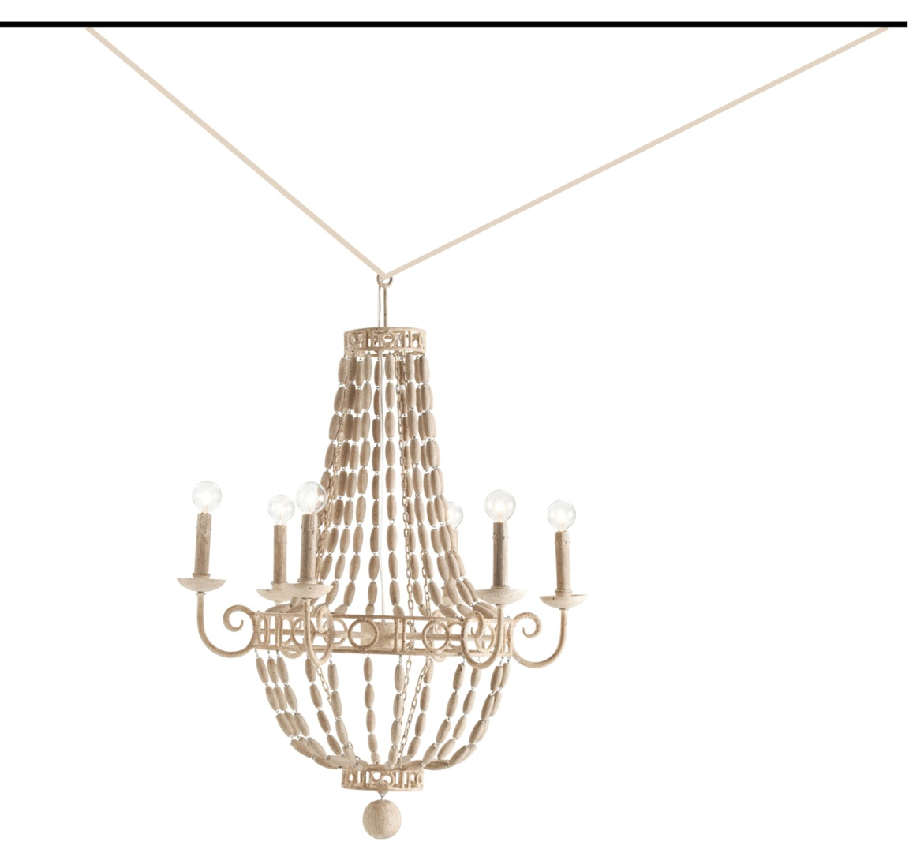
Equilibrium
Example 1.5k: Two wires are supporting a chandelier of mass 50 kg. What is the tension in each wire?
45º
30º

Slide 116
Homework, Context & Keywords
Context: How is this content used to better society?
To build roads, bridges, beams and cranes capable of supporting the needs of society.

Slide 117
Homework, Context & Keywords
Key Words
Rotational Equilibrium
Translational Equilibrium
Torque
Zero Torque
Moments
Perpendicular distance

Slide 118
Homework, Context & Keywords
Homework
Complete all questions from Set 1.5 - due first lesson next week.
Read Chapter 2.1 & 2.2, page 46-50 & 50-58 and answer
Q1 & Q2 Set 2.1
Q1, Q2 & Q3 Set 2.2
by next lesson.

